Slide 1
Cloud Resource Identification, Inventory and Grouping
Notes:
The ACE-Security course and all the presentations are created or organized by Shahzad Ali Please reach out to provide feedback so we can improve it.

Slide 2
Topics Covered
Tenet from NIST Publication 800-207 - Zero Trust Architecture (ZTA)
The enterprise collects as much information as possible about the current state of assets, network infrastructure and communications and uses it to improve its security posture.
Asset Inventory using Aviatrix CoPilot Asset Inventory
Resources identification using tags and other attributes
Resource Grouping using Aviatrix SmartGroups

Slide 3
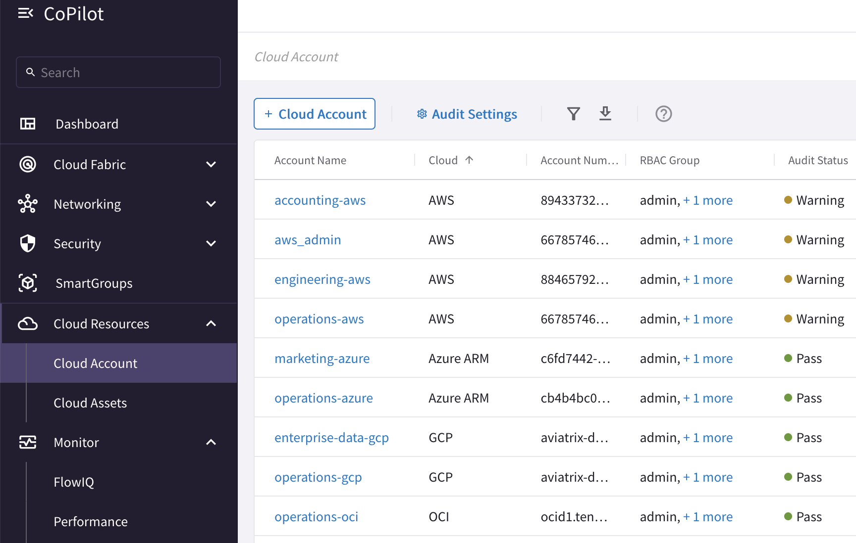
CSP Cloud Accounts Inventory

Slide 4
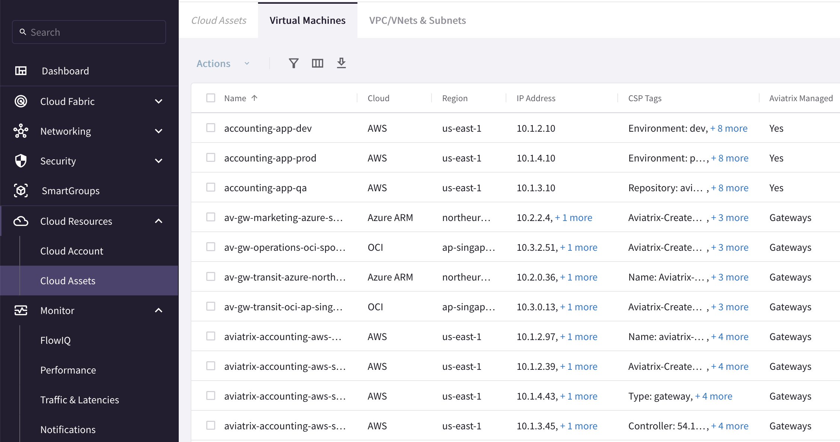
CSP Assets Inventory

Slide 5
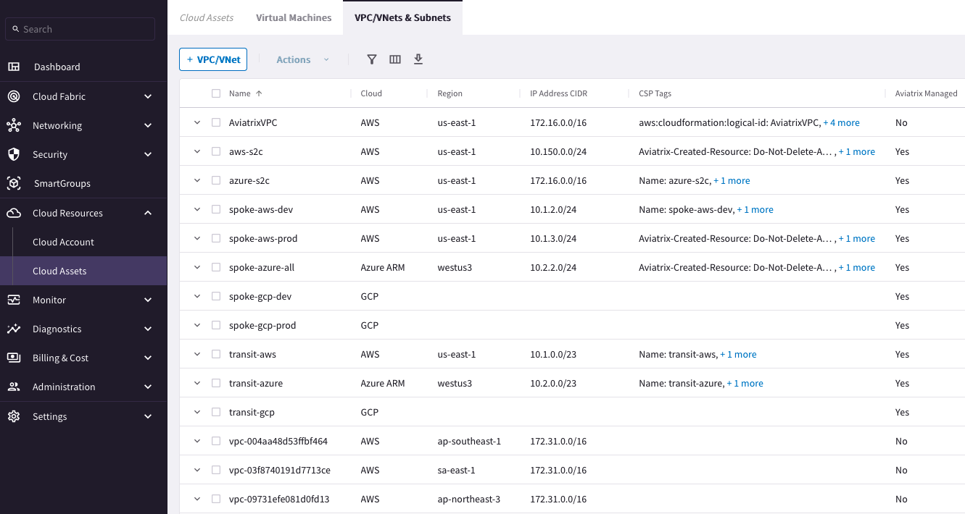
CSP Assets Inventory
GCP labels (tags) are NOT available for VPC or VPC Network
Default AWS VPC without tag

Slide 6
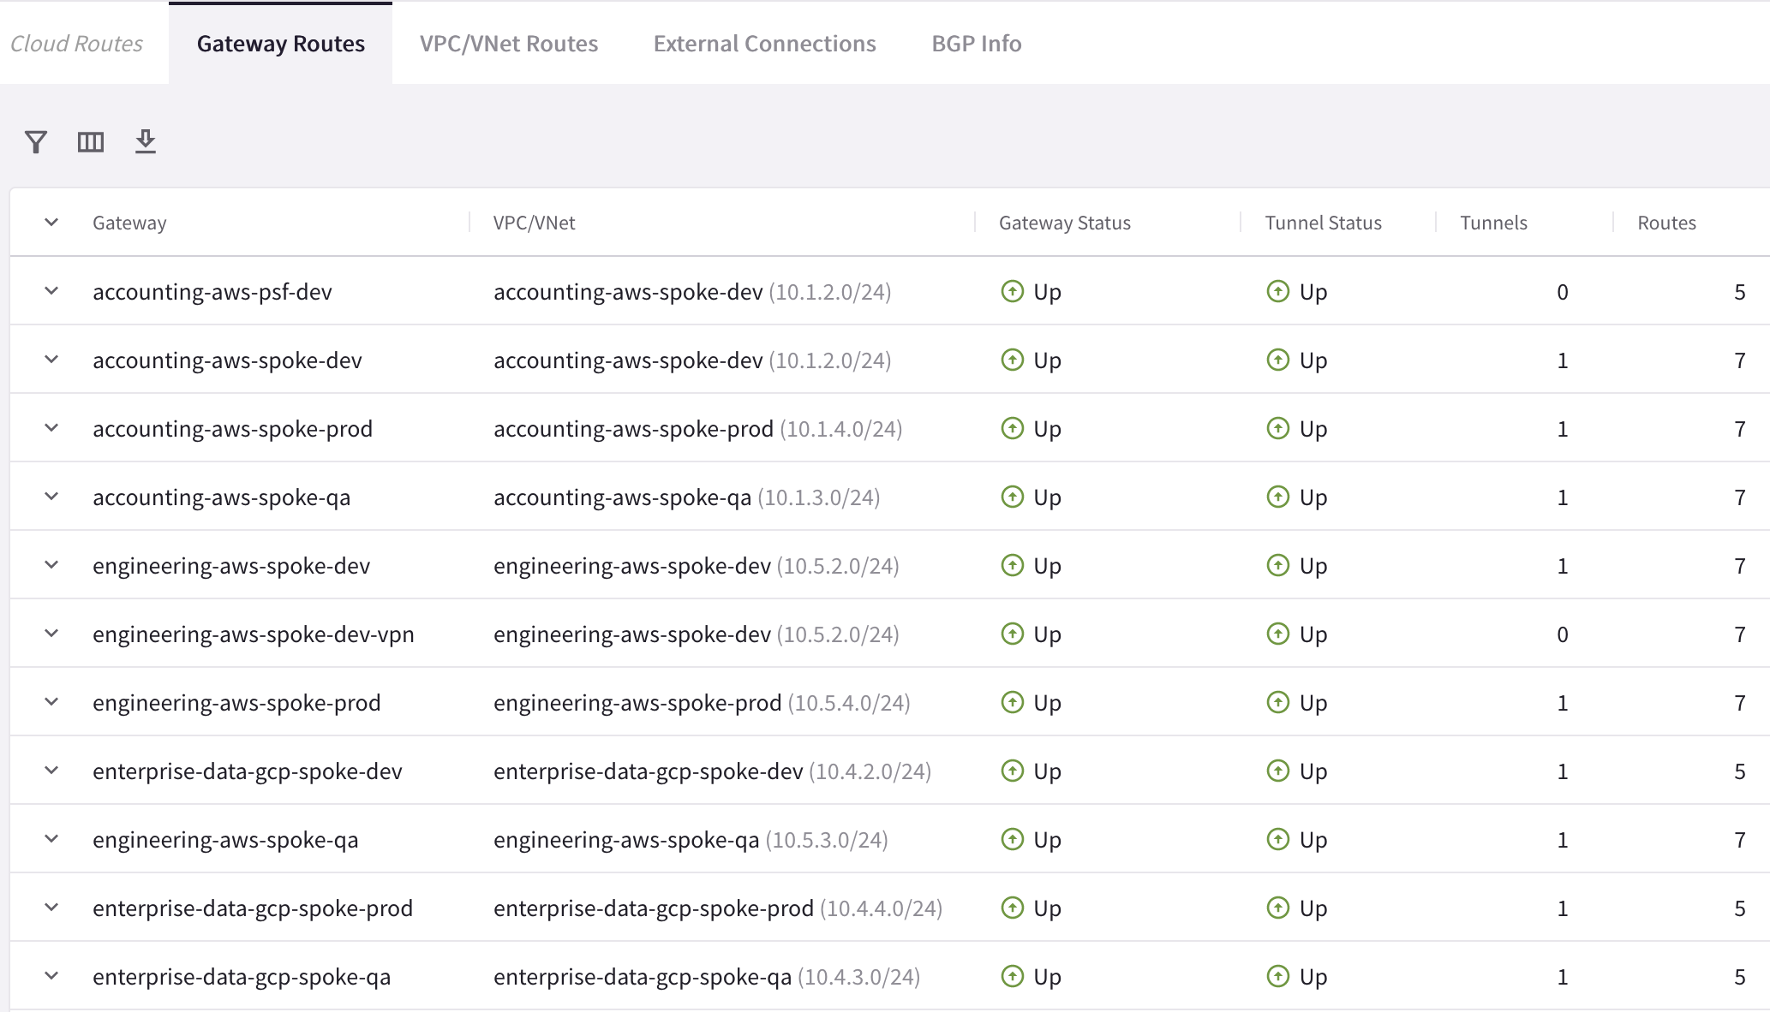
Global Routing Inventory – Aviatrix Gateway

Slide 7
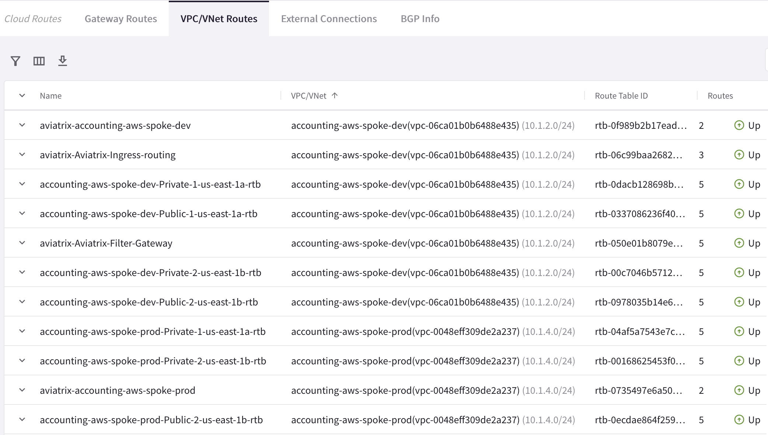
Global Routing Inventory – Cloud Routes

Slide 8



Aviatrix Smart Group
An Aviatrix Smart Group identifies a group of resources with similar policy requirements confined in the same logical container.
The members of a Smart Group can be classified using three methods:
CSP Tags (or labels)
Resource Attributes
CIDR
Notes:
Resources that belong to the same Smart Group can be classified with three methods:
1) Leveraging the CSP Tags, commonly used by customer to identify applications and they are in the form of a KEY-VALUE pair.
2) Leveraging the Resource Attributes: such as the Region Name and the Account Name
3) Leveraging the IP prefixes

Slide 9
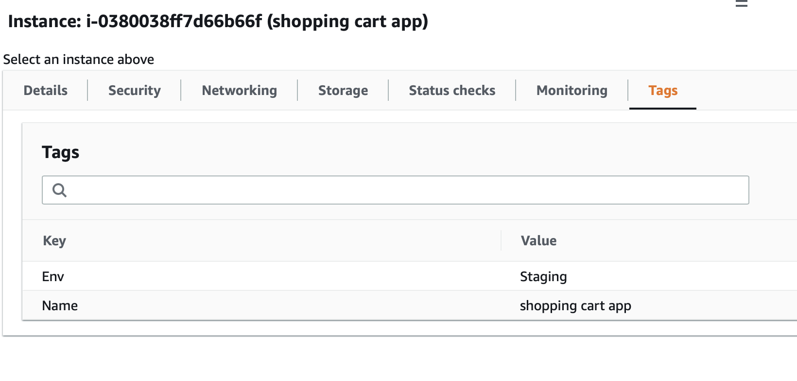
Classification Methods
CSP Tags (recommended)
Tags are assigned to:
Instance
VPC/VNET
Subnet
Tags are {Key, Value} pairs
Example: A shopping cart app can be tagged with:
{Key: Env, Value: Staging}
{Key: Name, Value: Shopping cart app}
Resource attribute
Region Name, Account Name
IP Prefixes
CIDR

Slide 10
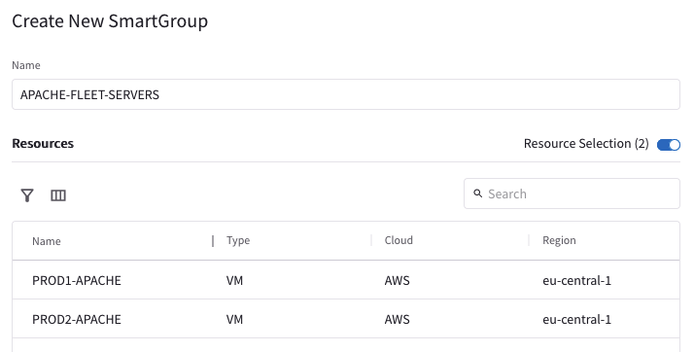
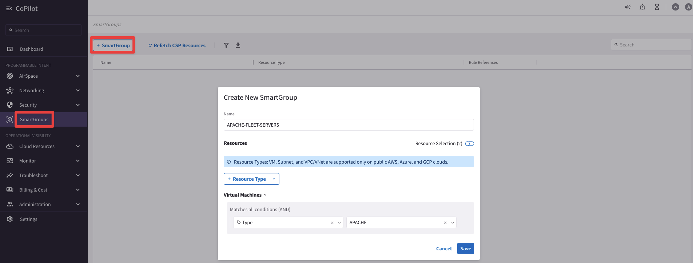

Smart Groups Creation
The controller polls the CSPs to retrieve inventory (about VPCs, instances, etc.) every 15 minutes (can be modified)
CoPilot queries Controller every 1 hour (can be modified)
On-demand refresh of tags is available

Slide 11
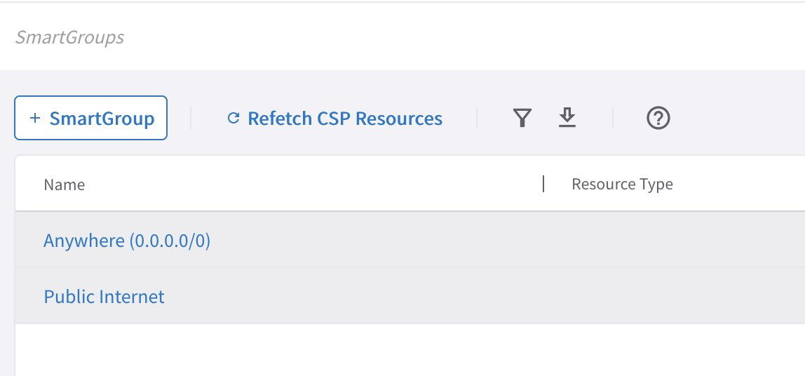
Pre-defined Smart Groups
Anywhere → Contains 0.0.0.0/0 CIDR (One member)
Public Internet → Contains Internet CIDRs (total of 31 members)

Slide 12
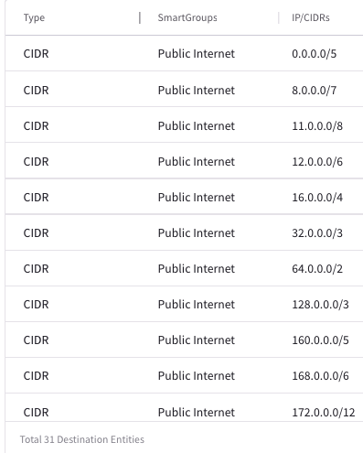
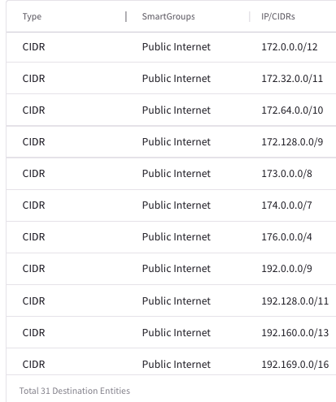
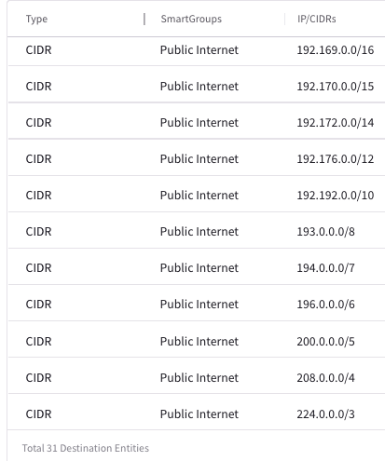
“Public Internet” SmartGroups Members (31 CIDRS Members)

Slide 13
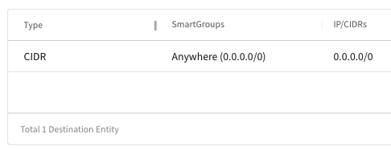
“Anywhere” SmartGroups Members (1 CIDR Member behind the scene)

Slide 14
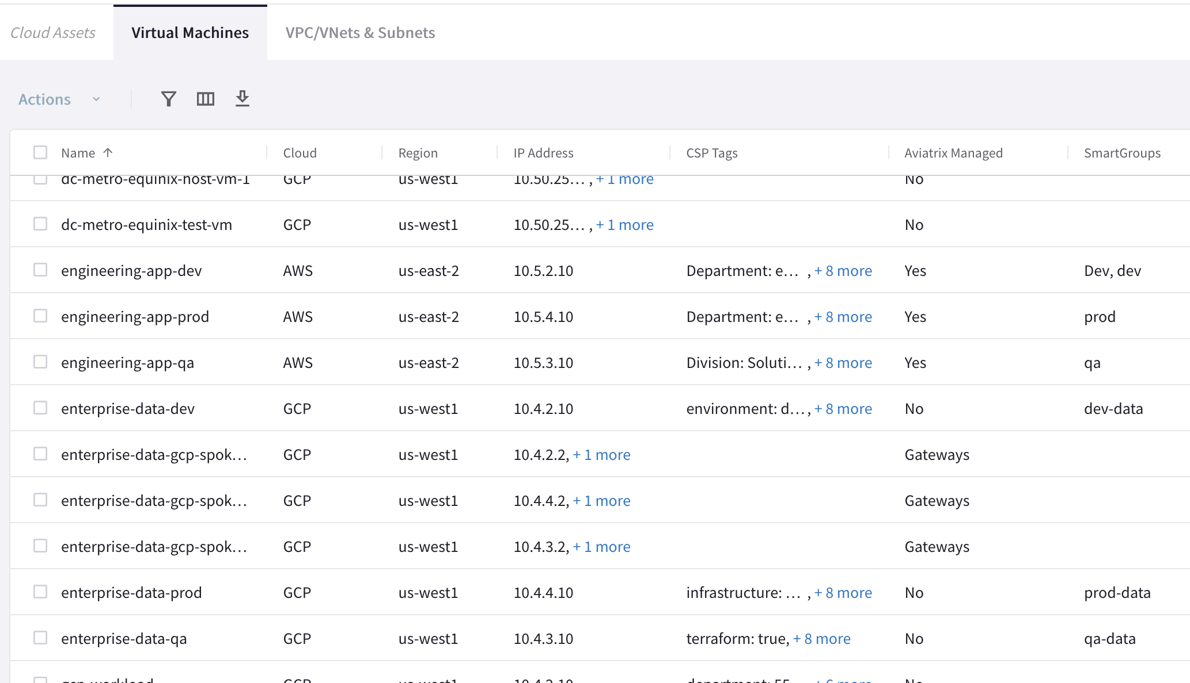
Asset Inventory with SmartGroups

Slide 15


Aviatrix Certified Engineer (ACE)
COMMUNITY
https://aviatrix.com/ACE
https://community.aviatrix.com

Slide 16
Aviatrix Security Solutions Reference Sheet
Learning Resources For Aviatrix Distributed Cloud Firewall for Egress | Partner Learning Resources For Aviatrix Distributed Cloud Firewall
Solution Overview Reduce Cost on native NAT webinar TCO Calculator (Save Cost, Improve Security) SelfService Tool to Deploy Aviatrix DCF For Egress https://selfservice.aviatrix.com/ Deployment Guide in AWS | Solutions Overview Aviatrix Distributed Cloud Firewall webinar TCO Calculator (Save Cost, Improve Security) Aviatrix Distributed Cloud Firewall Landing Page
Misc. Security Resources for Partners | Marketplace Listings
Deal Registration Partner Portal Partner Registration Previous Partner Webinars | AWS Azure GCP

Slide 17














AWS Cloud
AWS Step Functions
AWS Lambda
AWS CloudFormation
AWS Identity and Access Management (IAM)
Lambda function
Template
IAM Roles
VPC for Aviatrix Platform
VPC for Egress Testing
IGW
IGW
NAT Gateway
Aviatrix Gateway
Aviatrix
Controller
Aviatrix
CoPilot
Elastic IP address
Elastic IP address
Test EC2 Instance

Slide 18

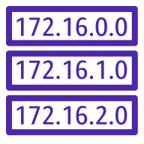


BLOCK Country1, Country 2
AWS Cloud
Patches
Updates
Code repos
SaaS
Anywhere
Internet
Anywhere
Standalone VPC with NAT Gateway
Standalone VPC with Aviatrix
IGW
IGW
NAT
NAT
FQDN Filtering
Threat Protection
Geo-Blocking
Visibility
EC2 Instances
EC2 Instances
NAT gateway
NAT gateway
Aviatrix Gateway
Aviatrix Gateway
Aviatrix
Controller
Cloud
Workloads
0.0.0.0/0 → IGW
0.0.0.0/0 → IGW
Public Subnets
Public Subnets
Aviatrix
CoPilot
Aviatrix
Secure Egress
Gateways
Route table
EC2 Instances
EC2 Instances
App 3
0.0.0.0/0 → NAT GW
0.0.0.0/0 → Aviatrix
App 2
Private Subnets
Private Subnets
AZ1
AZ2
AZ1
AZ2
App 1
ALLOW *.github.com, updates.ubuntu.com
EXCEPT gist.github.com
deny all

